Slide 1
Wireless Communication via UART on a DE2Bot
Nisarg Himani
Sunny Patel
Thomas Saekao
Mohit Tandon
George Vellaringattu
ECE 2031 Digital Design Laboratory L05
Georgia Institute of Technology
April 23, 2014
1
Notes:
Everyone

Slide 2
Project Objectives
Implement serial communication using UART
Communicate between base station and robot
Modify the given program that allows UART to:
Send messages to base station
Receive jobs from base station
Carry out jobs given by base station
Return home
2
Notes:
Nisarg

Slide 3
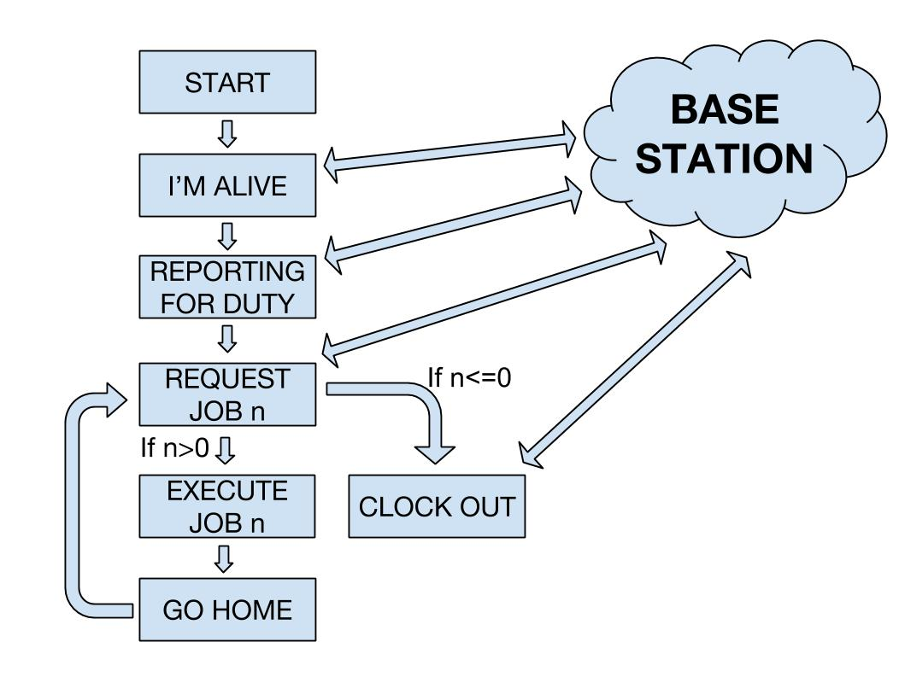
Flow Chart of Communication
3
Notes:
Sunny

Slide 4
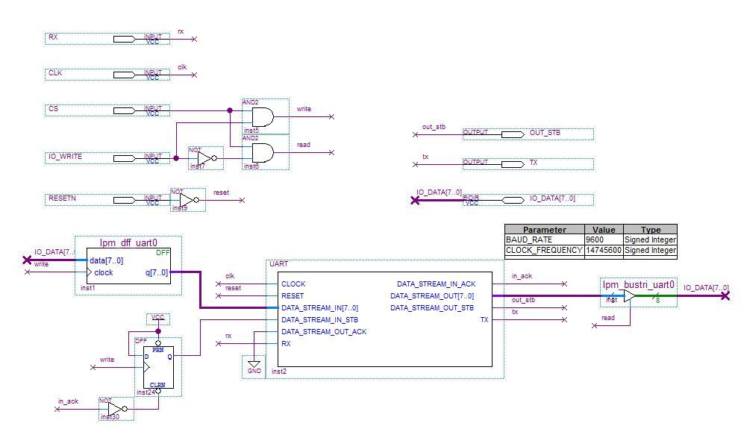
UART Interface
4
Notes:
Mohit
UART Implementation
Utilize DATA_STREAM_OUT_STB
Allow the interface to be asserted where there is a valid byte of data.

Slide 5
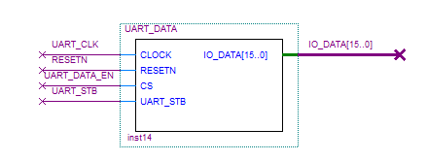
UART_DATA Interface
UART_STB comes from the UART interface
Asserts with valid data
Sets values for IO_DATA
I/O device verifies valid data without SCOMP
5
Notes:
Mohit
UART_STB comes from the UART Interface and is asserted when the data in the UART is valid.
When UART_STB is asserted, IO_DATA is set to 0x0001.
When UART_STB is deasserted, IO_DATA is set to 0x0000.
Used to verify if the data is valid without modifying the SCOMP interface.
I/O Device
A new I/O device was created to let the bot know when the DATA_STREAM_OUT_STB is asserted.
Once it is asserted data can be collected.
This I/O device prevents modifying the SCOMP.

Slide 6
Movement Design
Two states
Always facing out on the positive axes of the coordinate plane
Moves backwards to drop off job
Odometry, x-axis then y-axis
Movement Efficiency
Consistency
Fast and Furious
6
Notes:
George
Since we are only facing in the positive x- and y- direction, we don’t waste time rotating 180 degrees and face the negative x- and y- direction.
Together with movement efficiency and consistency, the bot moves quickly in the x- and y- direction and rotates quickly as well.

Slide 7
Constant Movement Values
Variable | Value | Description
FMedium | 480 | Forward Speed
RMedium | -480 | Reverse Speed
TurnConst | 11 | Right Wheel Forward +11
TurnConst2 | 7 | Right Wheel Reverse -7
Deg90 | 113 | 90° anticlockwise
Deg270 | 456 | 270° anticlockwise
7
Notes:
Thomas
We are rotating at a higher speed
Lower values for the degrees to allow for the momemtum of the bot and corrects for the rotation of the bot.
Q: Why CCW?
A: To keep it consistent, we kept everything consistent and easier to implement.

Slide 8


Example Movement Layout
(1,1)
(1,5)
3. Dropoff coordinate (1,5)
- Move in y-direction
- Rotate 270° anticlockwise
- Move in -x direction
4. Go Home
- Rotate 90° anticlockwise
- Move in -y direction
- Pick up bot and realign it
1. Starting position (1,1)
2. Pickup coordinate (3,4)
- Move in x-direction
- Rotate 90° anticlockwise
- Move in y-direction
(3,1)
(3,4)
(3,5)
8
Notes:
Sunny

Slide 9
Problems Encountered
Polar coordinates
Accuracy in movement and rotation
Speed versus job time
Different odometry calibrations of DE2Bots
Inconsistent sonar
9
Notes:
Nisarg
Accuracy in movement and rotation
Having both wheels move at an equal speed resulted in the robot veering towards one direction
The rotation angles were never a perfect 90 degree or 270 degree turn
Going home ( staying within the blocks )
Moving along legs versus moving along hypotenuse
Sonar was very buggy

Slide 10
Results
Failed turning 90° when going home after each job 1 time
Averaged 20 to 25 seconds per job
Completed all eight jobs in 225 seconds
Went out of the expected box 7 times
Picked up the bot 4 times
10
Notes:
Mohit

Slide 11
Discussion
Strengths:
Fast movement and rotation speed
Methodical movement
Minimal waiting time
Weaknesses:
Returns home after every job
Only counterclockwise rotation
11
Notes:
George

Slide 12
Comparisons
Proposed Design
Actual Design
12
Notes:
Thomas
Proposed
Connecting output of UART interface to SCOMP
Absolute movement based on current x,y position.
Keep moving until required x,y position is reached
Slow rotations
Back to back jobs without going home
Actual
Output of UART interface into i/o device
Relative movement. Store x,y coordinate and move the required distance.
Fast rotations
Going home after each job to reduce error propagation
Same
Cartesian coordinates
Odometry > sonar
Fast movement for x,y directions

Slide 13
Future Work: Polar Coordinates
Improving movement with the use of polar coordinates in terms of hypotenuse and theta values
1. Starting position (1,1)
2. Pickup coordinate (3,4)
- Rotate θ° anticlockwise
3. Dropoff coordinate (1,5)
- Rotate θ° anticlockwise
(1,5)
(1,1)
(3,4)
13
Notes:
Thomas

Slide 14
Future Work: Continuous Jobs
Being able to complete jobs one after another without the need to go home
Saving substantial amount of time to complete all eight jobs
14

Slide 15
Reference Slides

Slide 16
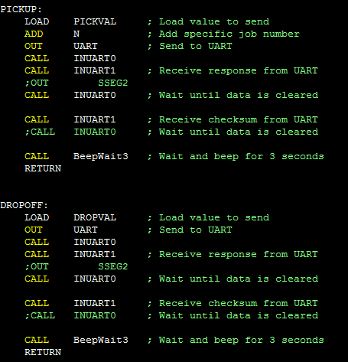
UART Pick-Up/Drop-Off Communication

Slide 17
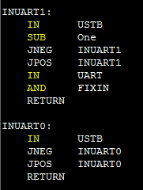
UART_STB Asserted/De-asserted Values

